Slide 1



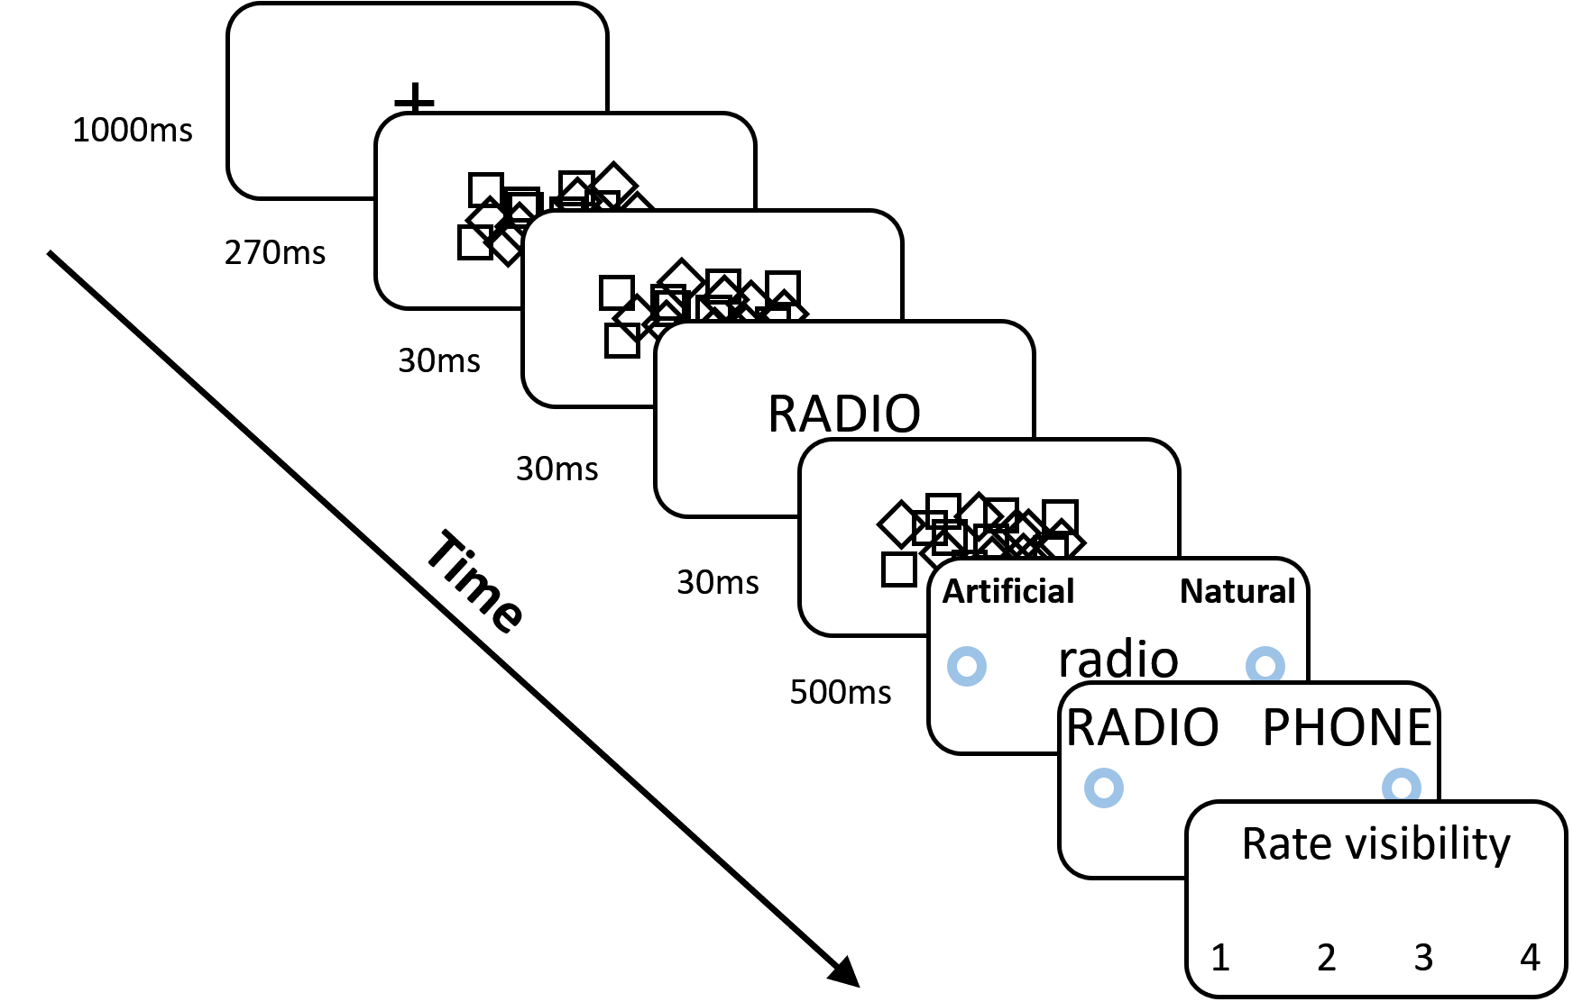
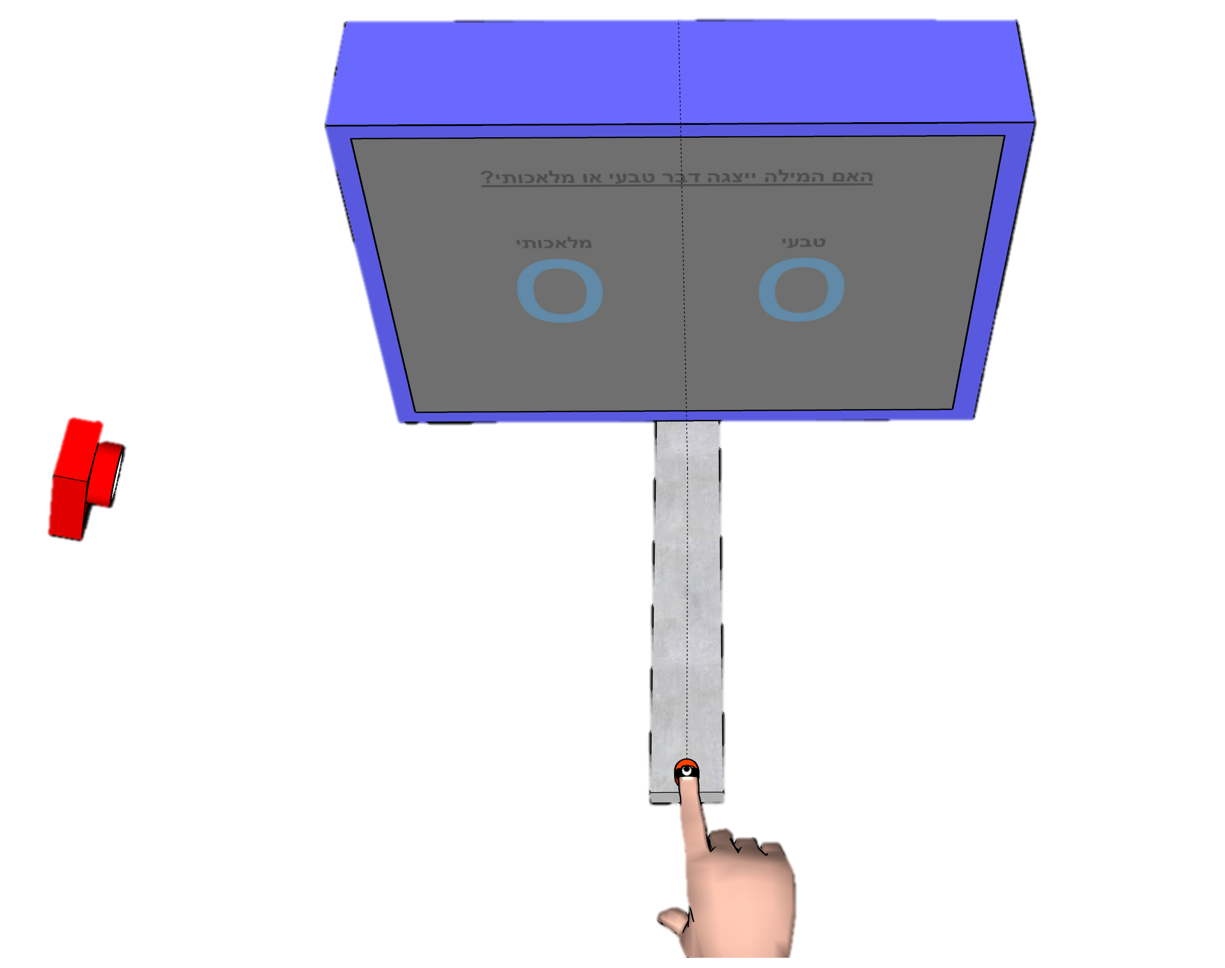
Show some sensitivity!
Using motion tracking to improve unconscious measures
Khen Heller¹, Liad Mudrik^{1,2} and Craig S. Chapman^{3,4}
1 Sagol School of Neuroscience, Tel Aviv University; 2 School of Psychological Sciences, Tel Aviv University; 3 Faculty of Kinesiology, Sport, and Recreation, University of Alberta, Edmonton, AB, Canada; 4 Neuroscience and Mental Health Institute University of Alberta Edmonton, Alberta, Canada
1
Introduction
3
Results
1
Motion tracking yields a significant effect for unconscious priming.
Unconscious effect is comparable to previous papers and larger than keyboard RT effect.
[lakens XXX]
Unconscious effect are hard to detect.
Motion tracking is continuous and richer than keyboard response.
This measure was used to unravel unconscious priming effects [1, 2, 3, 4, 5].
To date, only one study directly compared motion tracking with keyboard response [6].
Further support is necessary to verify the superiority of motion tracking as a measure of unconscious processing.
Pilot 1
Practice – reduce late responses incidence
2
Methods
Design:
Task:
Classify target as natural / artificial [7]
Setup
Measure
Pilot Study 1
N = 10
Test day
Trials = 240
Pilot Study 2
N = 11
Practice day + Test day
Trials = 560
Practice Day
Practice
6 blocks, w/o prime
*
Practice
1 block, w/o prime
Practice
1 block, with prime
Test
12 blocks, with prime
Test Day
Reach Area
Average Trajectory
Pilot 2
Screen
Reach Area
Motion
Tracking
RA
Y
Z
Z
Keyboard
RT
Motion
Tracking
RA
X
Average paths to the left and right targets
X
Mouse
Tracking
AUC
(A,C) Shaded area represents CI. (B,D) Black lines are SE. (E) AUC – area under the curve, area between the optimal path to the target and the actual path. RA – Reach area, area between average trajectories to the left and to the right targets.
* = p<0.05
References:
[1] Finkbeiner, M., & Friedman, J. (2011). The Flexibility of Nonconsciously Deployed Cognitive Processes: Evidence from Masked Congruence Priming. PLoS ONE, 6(2), e17095.
[2] Friedman, J., & Finkbeiner, M. (2010). Temporal dynamics of masked congruence priming: Evidence from reaching trajectories. Proceedings of the 9th Conference of the Australasian Society for Cognitive Science, 98–105.
[3] Finkbeiner, M., Song, J.-H., Nakayama, K., & Caramazza, A. (2008). Engaging the motor system with masked orthographic primes: A kinematic analysis. Visual Cognition, 16(1), 11–22.
[4] Cressman, E. K., Franks, I. M., Enns, J. T., & Chua, R. (2007). On-line control of pointing is modiﬁed by unseen visual shapes. Consciousness and Cognition, 11.
[5] Almeida, J., Mahon, B. Z., Zapater-Raberov, V., Dziuba, A., Cabaço, T., Marques, J. F., & Caramazza, A. (2014). Grasping with the eyes: The role of elongation in visual recognition of manipulable objects. Cognitive, Affective, & Behavioral Neuroscience, 14(1), 319–335.
[6] Xiao, K., Yamauchi, T., & Bowman, C. (n.d.). Assessing Masked Semantic Priming: Cursor Trajectory versus Response Time Measures. 7.
[7] Dehaene, S., Naccache, L., Cohen, L., Bihan, D. L., Mangin, J.-F., Poline, J.-B., & Rivière, D. (2001). Cerebral mechanisms of word masking and unconscious repetition priming. Nature Neuroscience, 4(7), 752–758.

Slide 2
Show some sensitivity!
Using motion tracking to improve unconscious measures
Khen Heller¹, Liad Mudrik^{1,2} and Craig S. Chapman^{3,4}
1 Sagol School of Neuroscience, Tel Aviv University; 2 School of Psychological Sciences, Tel Aviv University; 3 Faculty of Kinesiology, Sport, and Recreation, University of Alberta, Edmonton, AB, Canada; 4 Neuroscience and Mental Health Institute University of Alberta Edmonton, Alberta, Canada
1
Introduction
Methods
1
2
Unconscious effect are hard to detect.
Motion tracking is continuous and richer than keyboard response.
This measure was used to unravel unconscious priming effects [1, 2, 3, 4, 5].
To date, only one study directly compared motion tracking with keyboard response [6].
Further support is necessary to verify the superiority of motion tracking as a measure of unconscious processing.
Design:
Pilot 2, N = 11, Trials = 560
Practice day + Test day
Pilot 1, N = 10 Trials = 240
Test day
Practice Day
Practice
6 blocks, w/o prime
Practice
6 blocks
w/o prime
Practice
1 block
w/o prime
Practice
1 block
with prime
Test
12 block2
with prime
Practice – reduce late responses incidence
Practice
1 block, w/o prime
Practice
1 block, with prime
Test
12 blocks, with prime
Measure
RA: reach area between average paths to the left and right targets
Task:
Classify target as natural / artificial [7]
Test Day
Screen
RA
Y
Z
Z
X
X
3
Results
Motion tracking yields a significant effect for unconscious priming.
Pilot 1
Pilot 1
Effect Size Comparison
Unconscious effect
is comparableto previous papers
and larger than keyboard RT effect.
[lakens XXX]
Average Trajectory
Motion
Tracking
RA
Keyboard
RT
Motion
Tracking
RA
*
*
Mouse
Tracking
AUC
Reach Area
(A,C) Shaded area represents CI. (B,D) Black lines are SE. (E) AUC – area under the curve, area between the optimal path to the target and the actual path. RA – Reach area, area between average trajectories to the left and to the right targets.
* = p<0.05
References:
[1] Finkbeiner, M., & Friedman, J. (2011). The Flexibility of Nonconsciously Deployed Cognitive Processes: Evidence from Masked Congruence Priming. PLoS ONE, 6(2), e17095.
[2] Friedman, J., & Finkbeiner, M. (2010). Temporal dynamics of masked congruence priming: Evidence from reaching trajectories. Proceedings of the 9th Conference of the Australasian Society for Cognitive Science, 98–105.
[3] Finkbeiner, M., Song, J.-H., Nakayama, K., & Caramazza, A. (2008). Engaging the motor system with masked orthographic primes: A kinematic analysis. Visual Cognition, 16(1), 11–22.
[4] Cressman, E. K., Franks, I. M., Enns, J. T., & Chua, R. (2007). On-line control of pointing is modiﬁed by unseen visual shapes. Consciousness and Cognition, 11.
[5] Almeida, J., Mahon, B. Z., Zapater-Raberov, V., Dziuba, A., Cabaço, T., Marques, J. F., & Caramazza, A. (2014). Grasping with the eyes: The role of elongation in visual recognition of manipulable objects. Cognitive, Affective, & Behavioral Neuroscience, 14(1), 319–335.
[6] Xiao, K., Yamauchi, T., & Bowman, C. (n.d.). Assessing Masked Semantic Priming: Cursor Trajectory versus Response Time Measures. 7.
[7] Dehaene, S., Naccache, L., Cohen, L., Bihan, D. L., Mangin, J.-F., Poline, J.-B., & Rivière, D. (2001). Cerebral mechanisms of word masking and unconscious repetition priming. Nature Neuroscience, 4(7), 752–758.

Slide 3
Pilot 1
Unconscious effect are hard to detect.
Motion tracking is continuous and richer than keyboard response.
This measure was used to unravel unconscious priming effects [1, 2, 3, 4, 5].
To date, only one study directly compared motion tracking with keyboard response [6].
Further support is necessary to verify the superiority of motion tracking as a measure of unconscious processing.
Motion tracking yields a significant effect for unconscious priming.
*
1
Introduction
Methods
2
1
Practice Day
Practice
6 blocks, w/o prime
3
Pilot 2, N = 11, Trials = 560
Practice day + Test day
Practice – reduce late responses incidence
Practice
1 block, w/o prime
Practice
1 block, with prime
Test
12 blocks, with prime
Pilot 1, N = 10 Trials = 240
Test day
Design:
Task:
Classify target as natural / artificial [7]
Test Day
Practice
6 blocks
w/o prime
Practice
1 block
w/o prime
Practice
1 block
with prime
Test
12 block2
with prime
Results
Measure
RA: reach area between average paths to the left and right targets
Show some sensitivity!
Using motion tracking to improve unconscious measures
Pilot 1
Khen Heller¹, Liad Mudrik^{1,2} and Craig S. Chapman^{3,4}
1 Sagol School of Neuroscience, Tel Aviv University; 2 School of Psychological Sciences, Tel Aviv University; 3 Faculty of Kinesiology, Sport, and Recreation, University of Alberta, Edmonton, AB, Canada; 4 Neuroscience and Mental Health Institute University of Alberta Edmonton, Alberta, Canada
Average Trajectory
Screen
RA
*
Z
Reach Area
X
Motion
Tracking
RA
Keyboard
RT
Motion
Tracking
RA
Effect Size Comparison
Unconscious effect
is comparableto previous papers
and larger than keyboard RT effect.
[lakens XXX]
Y
Z
Mouse
Tracking
AUC
(A,C) Shaded area represents CI. (B,D) Black lines are SE. (E) AUC – area under the curve, area between the optimal path to the target and the actual path. RA – Reach area, area between average trajectories to the left and to the right targets.
* = p<0.05
X
References:
[1] Finkbeiner, M., & Friedman, J. (2011). The Flexibility of Nonconsciously Deployed Cognitive Processes: Evidence from Masked Congruence Priming. PLoS ONE, 6(2), e17095.
[2] Friedman, J., & Finkbeiner, M. (2010). Temporal dynamics of masked congruence priming: Evidence from reaching trajectories. Proceedings of the 9th Conference of the Australasian Society for Cognitive Science, 98–105.
[3] Finkbeiner, M., Song, J.-H., Nakayama, K., & Caramazza, A. (2008). Engaging the motor system with masked orthographic primes: A kinematic analysis. Visual Cognition, 16(1), 11–22.
[4] Cressman, E. K., Franks, I. M., Enns, J. T., & Chua, R. (2007). On-line control of pointing is modiﬁed by unseen visual shapes. Consciousness and Cognition, 11.
[5] Almeida, J., Mahon, B. Z., Zapater-Raberov, V., Dziuba, A., Cabaço, T., Marques, J. F., & Caramazza, A. (2014). Grasping with the eyes: The role of elongation in visual recognition of manipulable objects. Cognitive, Affective, & Behavioral Neuroscience, 14(1), 319–335.
[6] Xiao, K., Yamauchi, T., & Bowman, C. (n.d.). Assessing Masked Semantic Priming: Cursor Trajectory versus Response Time Measures. 7.
[7] Dehaene, S., Naccache, L., Cohen, L., Bihan, D. L., Mangin, J.-F., Poline, J.-B., & Rivière, D. (2001). Cerebral mechanisms of word masking and unconscious repetition priming. Nature Neuroscience, 4(7), 752–758.

Slide 4
1. Introduction
Unconscious effects are notoriously small, and thus controversial. Using a more suitable and sensitive measure could tip the scales of that debate. Cognitive processes are continuous, thus need a continuous measure. Motion tracking is: Continuous – Path reflects ongoing competing processes and fluctuations in confidence. Rich – yields multiple analyzable parameters. Motion tracking has been used to probe unconscious semantic, conceptual and response priming effects (). Exp 1 in: The flexibility of nonconsciously deployed cognitive processes: evidence from masked congruence priming Temporal dynamics of masked congruence priming: evidence from reaching trajectories, Exp1,2 in: Engaging the motor system with masked orthographic primes: A kinematic analysis Some researchers have even used both motion tracking and keyboard response measures. On-line control of pointing is modified by unseen visual shapes Exp 4 in: Grasping with the eyes: The role of elongation in visual recognition of manipulable objects However, to date, only 1 study showed a direct advantage for mouse tracking over keyboard response when investigating unconscious effects. Assessing Masked Semantic Priming: Cursor Trajectory versus Response Time Measures Future research is necessary that includes stricter measures of awareness, clearer semantic manipulations and a more natural response method
2. Methods
This pilot includes only a motion tracking group while a future version will also include a keyboard response group. Based Dehane's XXX exp. N = 13 (two of which were disqualified for a low number of valid trials (13 and 16). Training day: 240 trials, without prime. Test day: 40 practice trials w/o prime, 40 practice trials with prime, 480 test trials.
Day 1
Practice
6 blocks, w/o prime
Practice
1 block, w/o prime
Practice
1 block, with prime
Test
12 blocks, with prime
Day 2
Congruent
Incongruent
Screen
Z
Y
Z
X
X
3. Results
Day 2 only group Day 1+2 group Change diff ans same to congruent / incongruent Thicker line More transparent shding. Write under figures that Shading in Avg traj is CI. Make reach area square Change p value location. Remove p-value, put astriks instead and Add interpretation in the desc of figures. Reduce y-limits. Add colors to lines going up / down. Black lines are SE. Change analysis of bad trials for exp 2 subs, so that their trials won’t be counted as late_res. You need to change the part that adds ‘late_res’ to their data. Use only 1 legend for all graphs.
Day 1 + 2 group N=11
Average Trajectory
Results
Reach Area

Slide 5

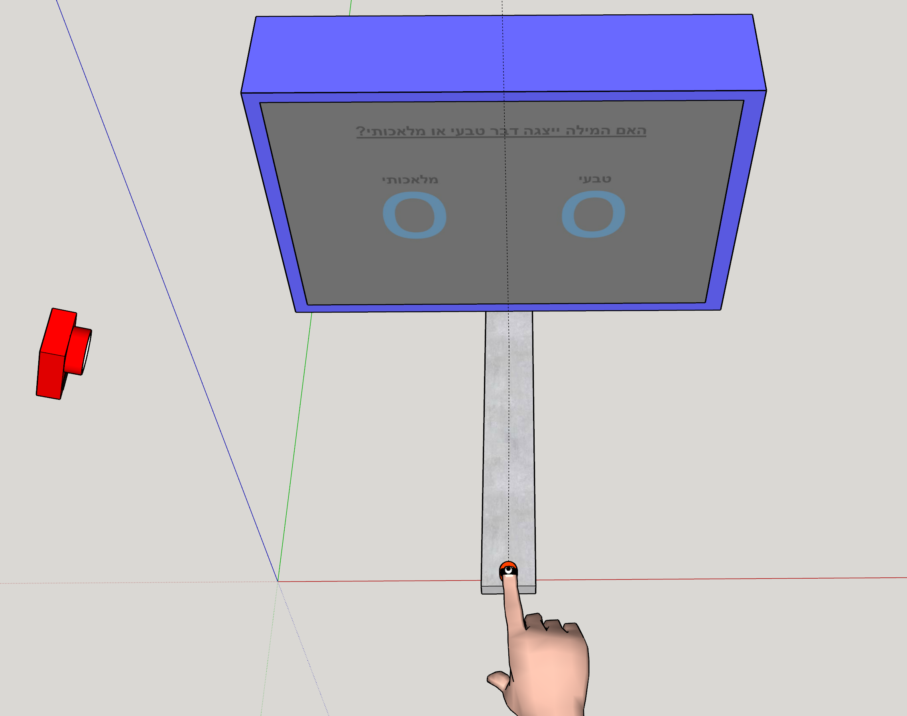
Congruent
Incongruent
Screen
1000ms
270ms
30ms
RADIO
Z
30ms
30ms
Artificial Natural
Time
500ms
radio
High Level
Cognition
Lab
RADIO PHONE
Rate visibility
1 2 3 4
X
Day 1
Practice
6 blocks
w/o prime
Y
Z
Practice
1 block
w/o prime
Practice
1 block
with prime
Test
12 blocks
with prime
X
Day 2
This is sub 40

Slide 6
3rd version
Using actual z value
2nd version
Using actual z value
3rd version
Using % of Z traveled
2nd version
Using % of Z traveled

